Slide 1
Clothing Recognition and Segmentation for Automatic Product Suggestions
Mohammad Ahmadi

Slide 2
Abstract
Goal
POSE Estimation
Segmentation
Feature Extraction
Similarity
Results
References

Slide 3
Goal
Automatic Product Suggestions for website or clothes shopping

Slide 4
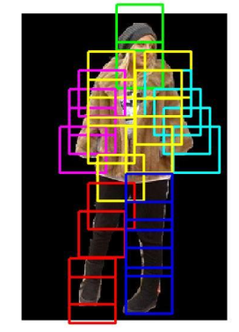
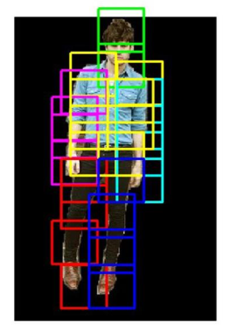
POSE Estimation

Slide 5
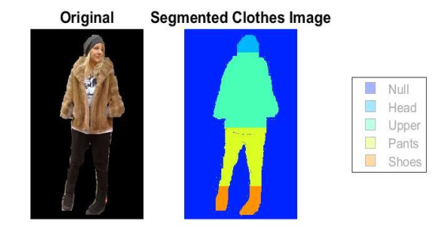
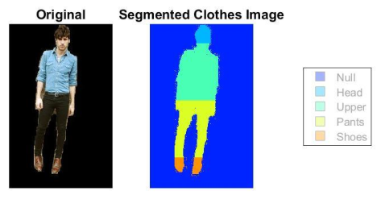
Segmentation

Slide 6
Feature Extraction
For product images, feature extraction can be done offline
Color Histogram
LBP
SIFT
HSV

Slide 7
Color Histogram
In image processing a color histogram is a representation of the distribution of colors in an image
To describe color we quantized the RGB values

Slide 8
LBP
For texture we used Local binary patterns
We l1-normalize color and texture features independently and then concatenate them to get the final 37-dimensional descriptor.

Slide 9
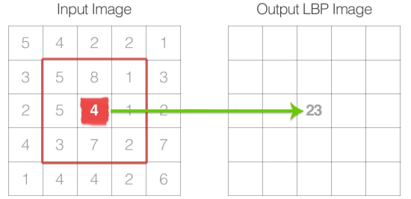
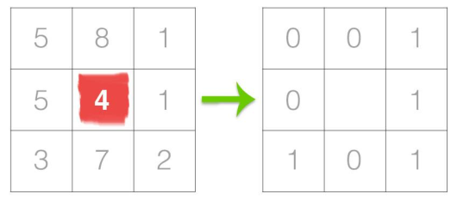
LBP

Slide 10
SIFT and HSV
We use SIFT descriptor for feature extraction.
HSV is the most common cylindrical coordinate representations of points in an RGB color model.

Slide 11
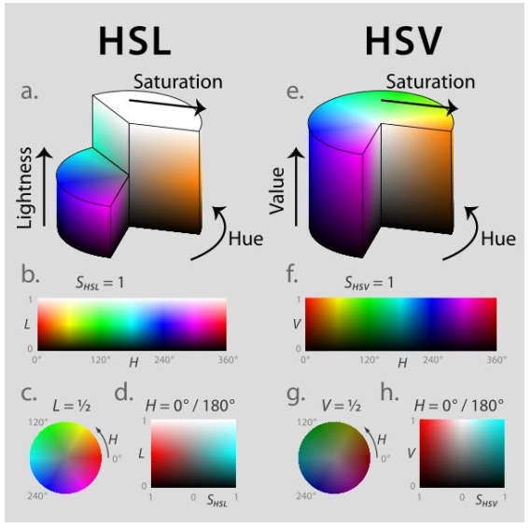

Slide 12
Similarity
Euclidean Distance and KNN
Cosine Similarity

Slide 13
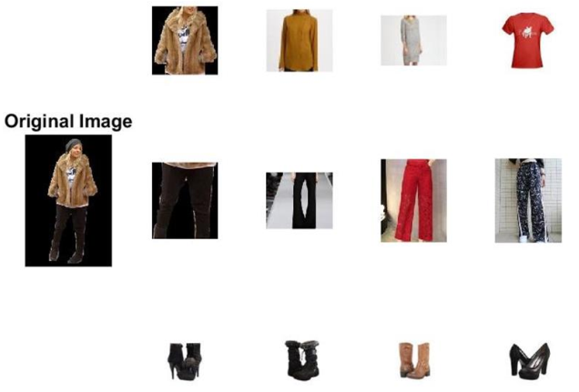
Results

Slide 14
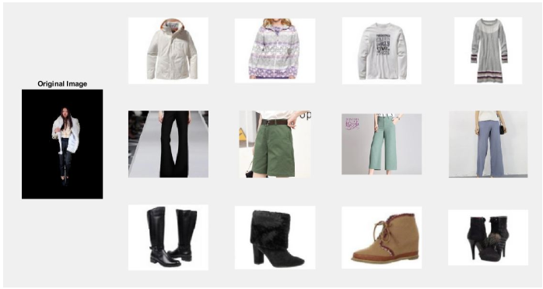
Results

Slide 15
References
1 - Y.Kalantidis, L.Kennedy . Getting the Look: Clothing Recognition and Segmentation for Automatic Product Suggestions in Everyday Photos
2 - Y. Yang and D. Ramanan. Articulated pose estimation with flexible mixtures-of-parts. In CVPR, 2011.
3 – Esther Hsu, Christie Paz, Shizhe Shen . Clothing Image Retrieval for Smart Shopping
4 - C. Rother, V. Kolmogorov, and A. Blake. Grabcut: Interactive foreground extraction using iterated graph cuts. In TOG, volume 23, pages 309{314, 2004

